Slide 1
Digital employees vs. analog bosses
Gabriel Decker

Slide 2
Herding the office
“People tend to imitate others through herding and can sometimes make incorrect adoption decisions. (E.g. adopting inferior technology)”(Sun, 2013).
“When people are free to do as they please, they usually imitate each other. –Eric Hoffer
People are uncertain about the decision to make for numerous reasons.

Slide 3
Time
Time = Experience.
Experience = Promotion
Promotion = You as new boss
Boss = Age
Age ≠ Wisdom

Slide 4
experience
It takes time and experience to become the Boss (Peterson, 2012). But, how can the boss stay current on trends and technology while maintaining their job?

Slide 5
Global Effects
The boss has to make sure his/her staff can make global connections through Skype, Face Book, Live Chat, Etc. But, How does he/she lead if they cannot use these programs to keep the company current?

Slide 6
Analog Bosses
Professional
Problems
Manners
Memorandums
Letters
If it is not broke, don’t fix it/cost efficient
Not Flexible
Formal Hierarchy
Resists change
All must conform
Technology changes
Do as I say

Slide 7
Analog antics
A good idea cannot come from someone working the desk because they do not have the skillset, only ideas from upper management are accepted and considered trustworthy. A good boss listens to the employees doing the work to find a better way to do the tasks at hand.

Slide 8
Digital world
Fast Paced
Changes can be expensive
Compatibility with others
YouTube / Training
When communicating with companies in more than one country how do you figure out compatible software and who do you listen too in the company?

Slide 9
Technology
Rapid changes where cost benefits may not pay off because the technology may be deemed useless in a matter of months. How does an analog boss decide which technologies to purchase and which to ignore?

Slide 10
Integration of new technology
The supplier must be able to transfer their knowledge and the buyer must be able to absorb this knowledge. This information must transfer from the IT department all the way to the CEO for him/her to agree to purchase (Ceccagnoli, 2012). The second problem is the cost of integrating the new technology with current programs within the company. The more understanding the CEO has the better the chance for new software to be licensed by the company (Arora, 1996).

Slide 11
When Waiting on technology
May have problems with the language with other companies
Skillset of employees may become inferior to competition
New software may be incompatible with older operating systems.
Save money in short term
Lose business because the business is not start of the art
Cost to bring an old company up-to-date can be enormous
Employees may be outdated

Slide 12
Skype, Foursquare, dropbox, droid
Technology has matured over the 20th century but some bosses are still afraid of commitment. The technologies are simpler to use, but bosses are scared of being infiltrated with viruses.
If the new technology failed to cost-effectively integrate, adoption was often halted.
How do you prove to the analog boss that the end use will be a true benefit?
Notes:
(Andriole, 2014)

Slide 13
It rolls down hill
Information cascades downhill and most people defer to the herd even if they disagree.
How does IT push technology uphill and through the herd?
It is not just the boss that becomes the obstacle, but the other sheep pushing against change.

Slide 14
Boss vs. Information technology
IT can use social media to prove the worth and attempt to lead the herd.
Boss may show his authority and see things as a power struggle.

Slide 15
Senior employees
Older employees have settled in and conformed. The herd has lost its spirit.
And does not want to learn new things. The herd will side with the senior staff. Senior staff’s favorite saying is, “Been doing it this way for years.” They will fight technology so they do not feel inferior to younger generation.

Slide 16
Youth
Energized and ready for rapid changes.
Does not believe in a formal meeting situation,
Looks for efficiency.
May be too eager and wants change now.
Can create confusion within the herd.

Slide 17
Sex in file cabinets
Employees refer to older works and regurgitate writing’s of the past.
Is this done from fear or laziness.
College has not prepared the employee to write these types of documents and the employee is “assimilated” to the herd.

Slide 18
Email/Text/Emoticons
Text messages seem less formal to a boss.
Email does not seem to have the formality of a memorandum.
Messages can come across cold and without emotion.
Emoticons have now place in a formal market.
How do we find a balance between old and new?

Slide 19
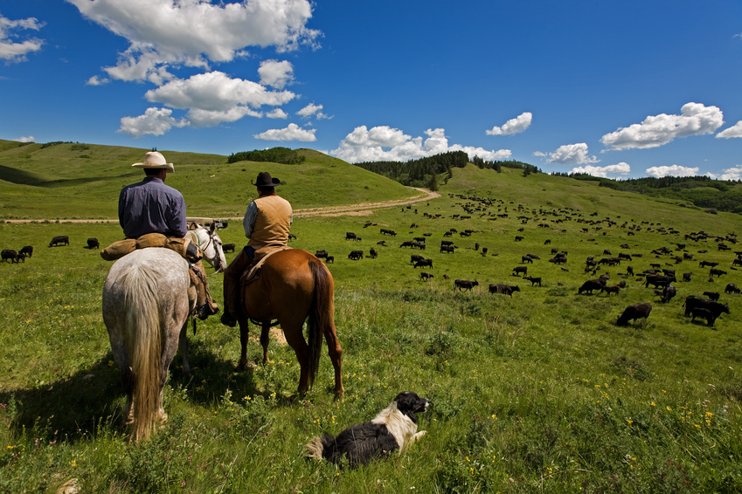
Today
Cost is minimal for many technologies a company may want to use. The ease of use and simple to understand instructions allow bosses to be on board. The herd is already following these patterns outside the office, so the boss must follow the herd to lead. Global economies is forcing companies to keep up in order to do business. Bosses understand they must do what is necessary for a positive bottom line but how will they lead their herd?

Slide 20
Summary
Not all change is bad and too much may not be necessary. Each boss must figure out which technology is best for his/her company without lengthy meetings and costly studies. A boss must rely on his/her employees to help in this decision process. It is a delicate balance of trust and growth that must deviate from traditional ways.

Slide 21
Bibliography
Andriole, S. (2014). Ready Technology. Viewpoints, 40 - 42.
Arora, A. (1996). Contracting for tactic knowledge: the provision of technical serices in technology licensing contracts. Journal of Development Economics, 233 - 256.
Ceccagnoli, M. a. (2012). The Cost of Integrating External Technologies: Supply and Demand Drivers of Value Creation In The Markets for Technology. Strategic Management Journal, 404 - 425.
Johns, L. C. (1989). The File Cabinet Has a Sex Life: Insights of a Professional Writing Consultant. Worlds of Writing Teaching and Learning in Discourse Communities of Work, 153 - 187.
Peterson, M. (2012, October 25). Remove the Cobwebs and Stop Sharing You Home with Spiders. Retrieved from Mini Mops, Inc. Exceptional House Cleaning: http://minimops.wordpress.com/2012/10/25/remove-the-cobwebs-and-stop-sharing-your-home-with-spiders/
Sun, H. (2013). A Longitudinal Study of Herd Behavior in teh Adoption and Continued Use of Technology. MIS Quarterly, 1013 - 1041.

